Slide 1
AIRLINE DELAY & CANCELLATION ANALYSIS
Himanshu Gandhi (1770138)
Shubham Prasad Sahoo (1824661)
Venkata Shreya Kala (1764875)

Slide 2


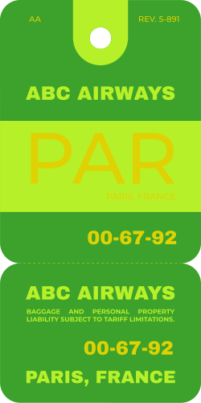

Outline
Problem Statement
Dataset
Feature Description
Exploratory Data Analysis
Data Pre-processing
Modelling Methods
Results
Model Critique
Conclusion

Slide 3
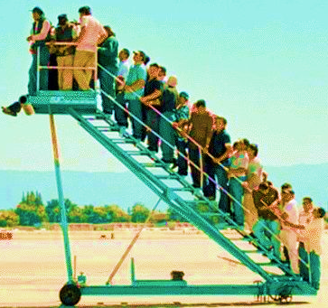
Problem Statement
The surge in Air Travel has resulted in a notable uptick in flight delays, intensifying airport congestion and imposing financial burdens on the airline sector.
These delays not only inconvenience passengers but also impose significant economic burdens, with estimates suggesting annual costs reaching billions of dollars.
Our study aims to forecast flight delays to improve both passenger experience and operational efficiency within the aviation industry.

Slide 4
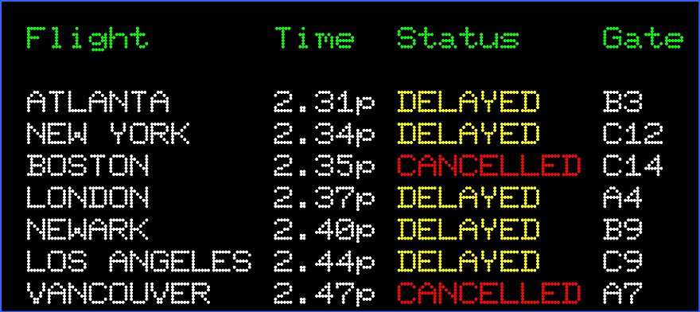
Exploring Airlines Data
Our study utilizes a Kaggle dataset, for the year 2015, to gain insights into the operational challenges and reliability of air transportation services during this timeframe.
The dataset comprises 5 million rows and 28 columns.
It includes numerical and categorical (including Binary) data types, reflecting various essential information crucial for investigating Airline delays.
The dataset includes essential information on temporal dynamics, operational details, geospatial information, and delay classifications.
This dataset forms the backbone of our analysis and preprocessing tasks, allowing us to delve into the details of airline operation delays and find effective solutions.

Slide 5
An Overview – Dataset Features
Categories | Feature Name | Sample Values | Feature Description
DATE & TIME | FL_DATE | 2015-01-01 | The Date of the Flight
 | CRS_DEP_TIME | 2147, 1050, 700 | Schedule Departure Time (HHMM)
 | DEP_TIME | 2147, 1050, 700 | Actual Departure Time (HHMM)
 | CRS_ARR_TIME | 2250, 1404, 757 | Scheduled Arrival time (HHMM)
 | ARR_TIME | 2245., 1403., 813. | Actual Arrival time (HHMM)
FLIGHT DETAILS | OP_CARRIER | 'NK', 'MQ', 'OO', 'EV', ‘HA' | The Name of the Carrier
 | OP_CARRIER_FL_NUM | 195, 197, 198 | Flight Number of the Carrier
 | ORIGIN | 'MCO', 'LGA', 'FLL', 'IAH' | Origin Airport
 | DEST | 'FLL', 'MCO', 'LAS', 'ORD' | Destination airport
 | DISTANCE | 177., 1076., 1222. | Distance between airports (miles)
TIME METRICS | TAXI_OUT | 15., 20., 19., 8. | Taxi Out Time, in Minutes; The time elapsed between departure from the origin airport gate and wheels off.
 | WHEELS_OFF | 2158., 1124., 731. | Wheels Off Time (local time) in HHMM
 | WHEELS_ON | 2158., 1124., 731. | Wheels On Time (local time) in HHMM
 | TAXI_IN | 7., 9., 10., 4., 5. | Wheels down and arrival at the destination airport gate, in minutes
 | CRS_ELAPSED_TIME | 63., 194., 57., 196. | Estimated Elapsed Time of Flight, in Minutes
 | ACTUAL_ELAPSED_TIME | 63., 194., 57., 196. | Elapsed Time of Flight, in Minutes
 | AIR_TIME | 40., 150., 32., 164. | Flight time in Minutes
DELAY INFORMATION | DEP_DELAY | -4., 14., 12. | Difference in minutes between scheduled and actual departure time. Early departures show negative numbers.
 | ARR_DELAY | -5.0, -1.0, 16.0 | Difference in minutes between scheduled and actual arrival time. Early arrivals show negative numbers.
 | CANCELLED | 0., 1. | Cancelled Flight Indicator (1=Yes); was the flight cancelled?
 | CANCELLATION_CODE | 'A', 'B', 'C', 'D' | Reason for cancellation (A = carrier, B = weather, C = NAS, D = security
 | DIVERTED | 0., 1. | Diverted Flight Indicator (1 = Yes)
 | CARRIER_DELAY | 1., 15., 127., 174. | Carrier Delay, in Minutes
 | WEATHER_DELAY | 31., 17., 24., 61. | Weather Delay, in Minutes
 | NAS_DELAY | 16., 18., 25., 19. | National Air System Delay, in Minutes
 | SECURITY_DELAY | 8., 21., 6., 14. | Security Delay, in Minutes
 | LATE_AIRCRAFT_DELAY | 8., 29., 21., 10. | Late Aircraft Delay, in Minutes

Slide 6
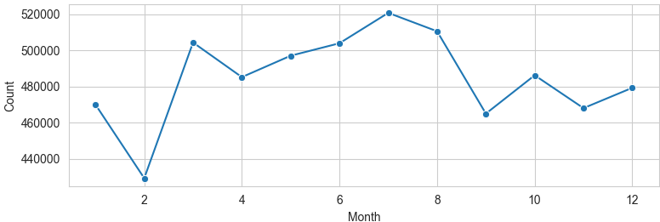
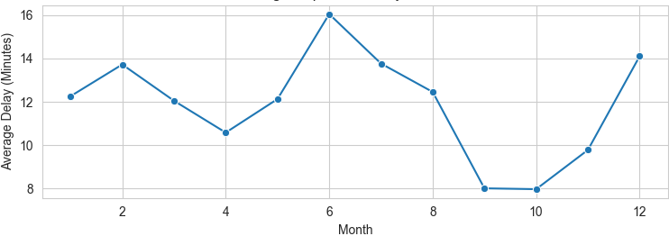

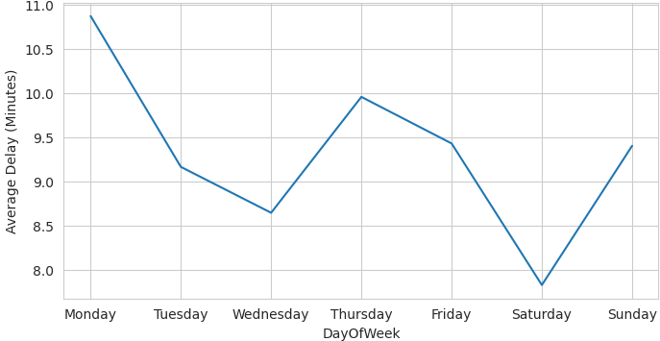
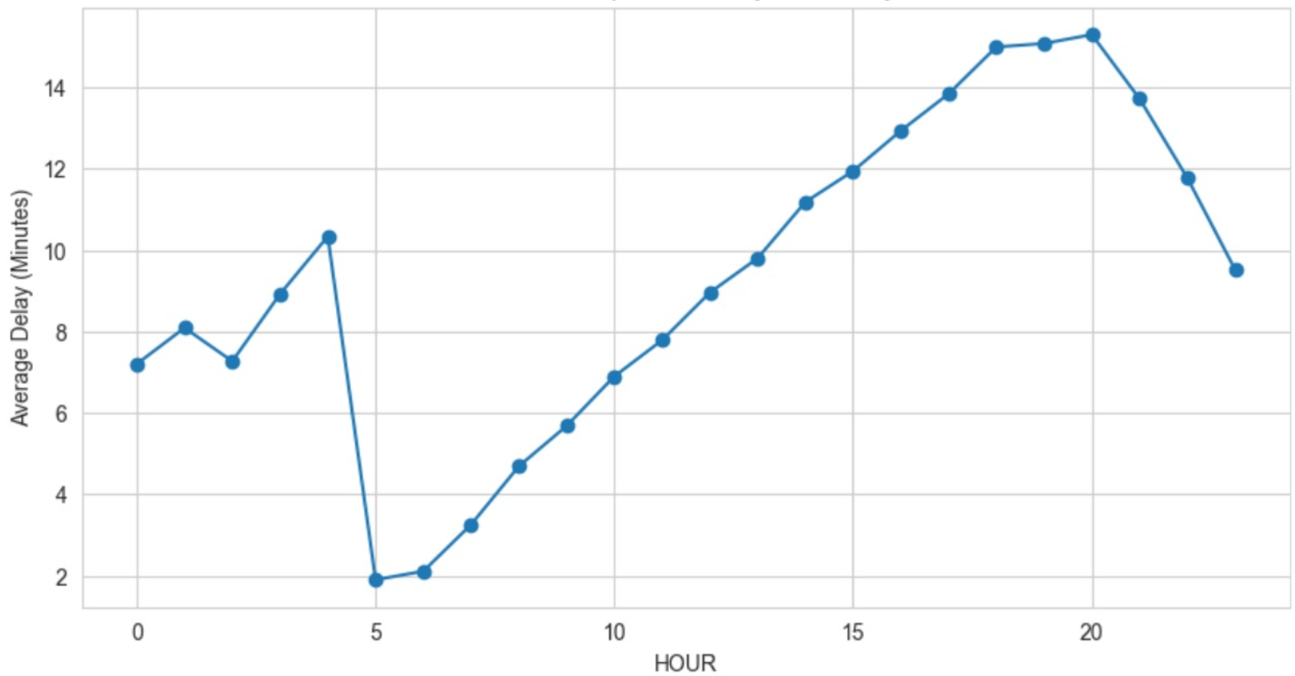
Exploratory Data Analysis
Flight Counts Per Month
Average Departure Delay Per Month
Seasonality shift in the flights count per month
Avg. Departure delay goes well with the seasonality shift
Average Departure Delay Over Day of Weeks
Average Departure Delay Over Hours of a Day

Slide 7
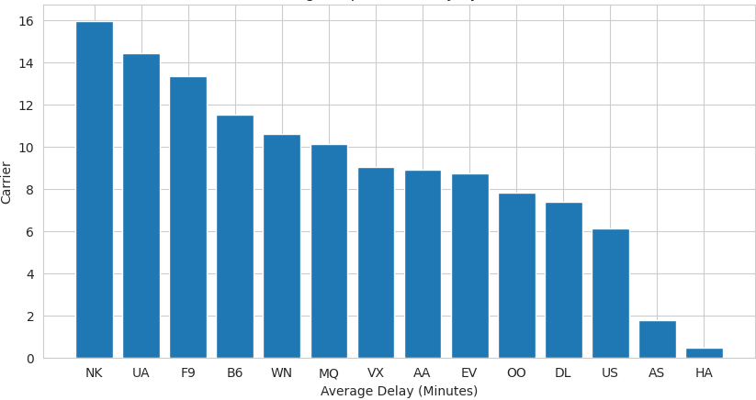
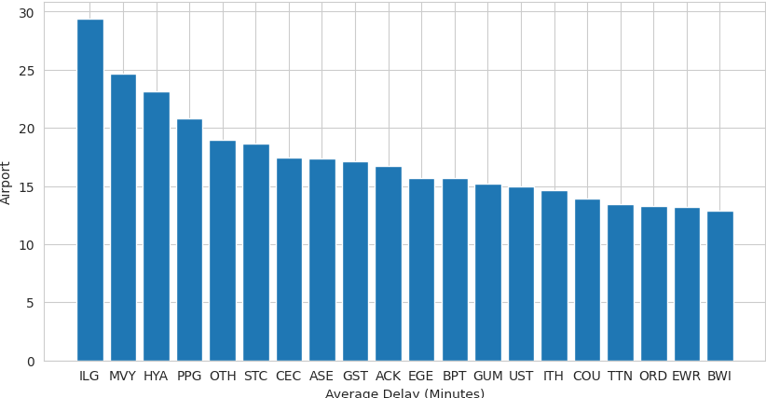
Exploratory Data Analysis – Cont.
Average Departure Delay by Carrier
Top 20 Airports by Average Departure Delay
Provides insights into the punctuality performance of airlines
Highlights potential areas of congestion and operational challenges within the aviation system
Notes:
ILG (Wilmington Airport, Delaware, USA):
Possible reasons for delays: Wilmington Airport is a small regional airport, and smaller airports often have fewer resources and infrastructure to handle flights efficiently. Delays could be due to limited staffing, fewer runways, or less advanced air traffic control systems.
MVY (Martha's Vineyard Airport, Massachusetts, USA):
Possible reasons for delays: Martha's Vineyard Airport serves a popular tourist destination, especially during peak seasons like summer. Increased passenger traffic during these times can lead to congestion, longer queues for takeoff and landing, and overall delays in flight schedules.
HYA (Barnstable Municipal Airport, Massachusetts, USA):
Possible reasons for delays: Similar to Martha's Vineyard Airport, Barnstable Municipal Airport serves a region known for tourism, particularly Cape Cod. Like other tourist destinations, increased seasonal travel can strain airport resources and contribute to delays.
PPG (Pago Pago International Airport, American Samoa):
Possible reasons for delays: Pago Pago International Airport is located in a remote area and serves a relatively small population. Limited infrastructure, adverse weather conditions, and fewer flight options may contribute to delays at this airport.
OTH (Southwest Oregon Regional Airport, Oregon, USA):
Possible reasons for delays: Southwest Oregon Regional Airport is situated in a region known for its rugged terrain and variable weather conditions. Adverse weather, such as fog or high winds, could impact flight operations and result in delays.
NK (Spirit Airlines):
Possible reasons for delays: Spirit Airlines is known for its no-frills, low-cost model, which often involves quick turnarounds between flights. However, this can lead to challenges in maintaining on-time departures, especially if there are any issues with aircraft maintenance, ground operations, or crew scheduling.
UA (United Airlines):
Possible reasons for delays: United Airlines operates a vast network of flights, including many connecting flights at major hubs. Delays can occur due to factors such as air traffic congestion, weather-related disruptions, and operational issues at busy airports.
F9 (Frontier Airlines):
Possible reasons for delays: Frontier Airlines is an ultra-low-cost carrier that focuses on point-to-point travel. Delays may occur due to factors such as limited staffing, quick aircraft turnarounds, and scheduling challenges associated with managing a diverse route network.
B6 (JetBlue Airways):
Possible reasons for delays: JetBlue Airways operates primarily in the eastern United States and the Caribbean, with a focus on customer service and amenities. Delays may occur due to factors such as weather-related disruptions, airspace congestion, and operational challenges at busy airports like New York's JFK.
WN (Southwest Airlines):
Possible reasons for delays: Southwest Airlines is one of the largest low-cost carriers in the world, known for its point-to-point service model and high frequency of flights. Delays may occur due to factors such as air traffic congestion, weather-related disruptions, and operational issues at busy airports.

Slide 8
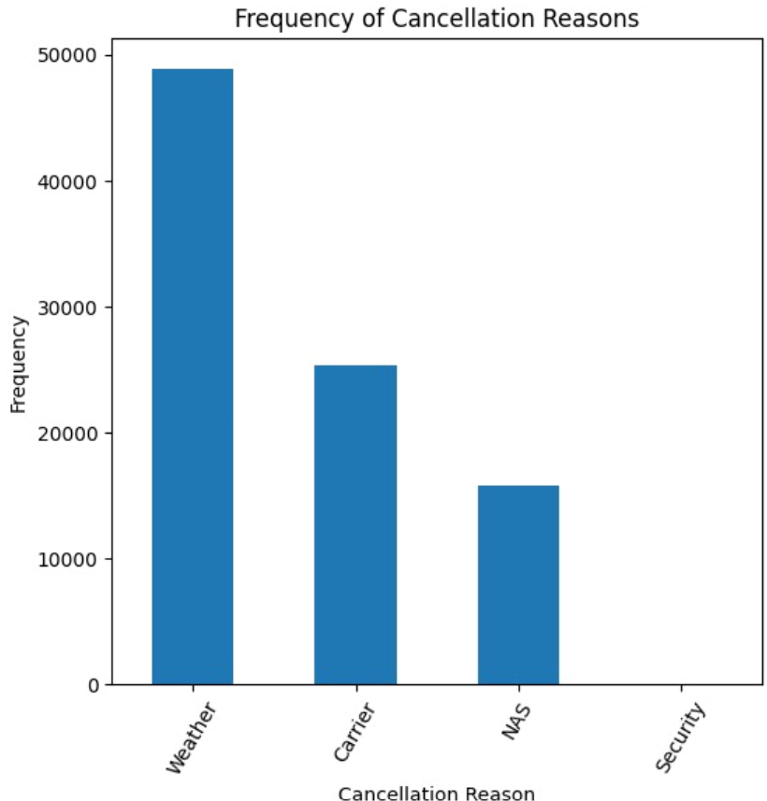
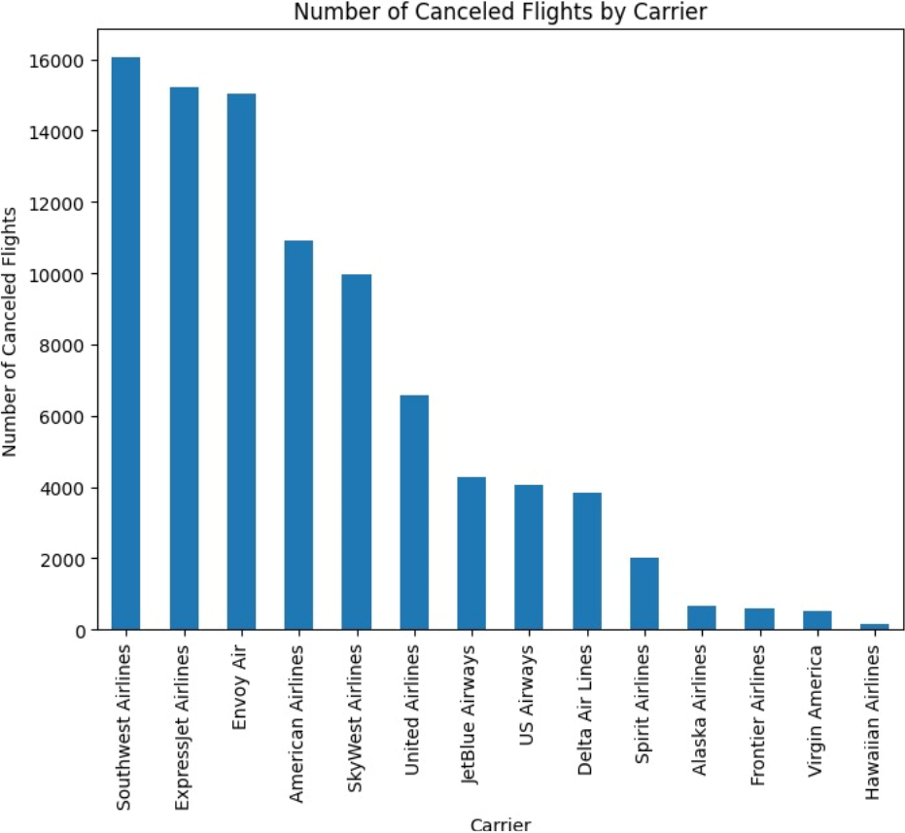
Exploratory Data Analysis – Cont.
Airline Cancellation Analysis

Slide 9





Exploratory Data Analysis – Cont.
NOT REQUIRED FEATURES
IMPORTANT FEATURES
FLIGHT NUMBER
FLIGHT DATE
DESTINATION
CARRIER
DEPARTURE TIME
ORIGIN
SCHEDULED DEPARTURE TIME
CANCELLATION CODE
DIVERTED
DEPARTURE DELAY
ARRIVAL RELATED FEATURED
TYPES OF DELAYS
Notes:
For Simple Explanation: EDA involves examining and understanding the structure, patterns, and relationships within the dataset. We explore the columns, check for missing values, identify unusual observations like: instances of exceptionally long delays or cancellations that deviate significantly from the normal delay time.

Slide 10
Data Pre-Processing Techniques
Extracting Weather Insights
Precipitation
Average Temperature
One Hot Encoding
Hour of day
Extracting Time Related Features
Hour of day
Wind Speed
Day of Week
Flight carriers
Day of Week
Month of year
Additionally, Data manipulation operations like handling null values for weather data, correcting the format of variables etc. were also conducted.
Notes:
Scraped weather data(lots of unique origin airports, diff preproc, origin represents the location->weather) Ohe on hour of day, dayofweek and carrier Extracting time features from datetime
Extra, if you want to add: Data manipulation like handling null values for weather data, correcting the format of variables. (doesnt seem imp)

Slide 11
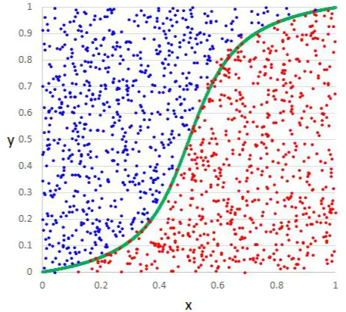
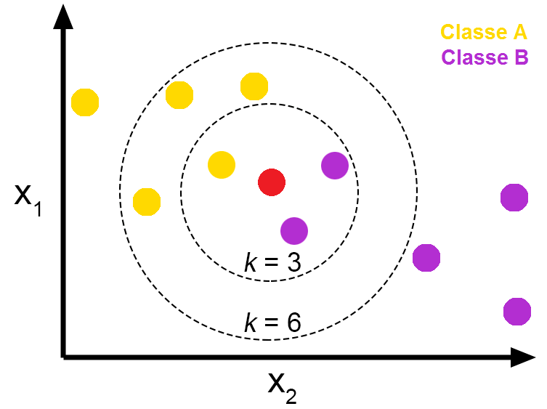
Modeling Approaches
Logistic Regression
Draws a S curve to separate things into two groups based on their features and predicts the probability of belonging to each group
K Nearest Neighbor
Categorizes new instances by comparing them to a set number of nearby instances and assigning the most common label among these neighbors to the new instance.
Notes:
Logistic regression:
So, when we want to sort a new thing, it looks at its features and guesses which group it might belong to based on where it falls on the line.
It looks at the characteristics of each fruit and tries to draw a line (or boundary) between apples and oranges based on those characteristics. This line helps us separate the two groups.
But here's the twist: Instead of just drawing a straight line, logistic regression uses a special kind of curve called the "S-curve." This curve allows logistic regression to not only separate the fruits into two groups but also to give us the probability that each fruit belongs to one group or the other.
So, when we use logistic regression to classify a new fruit, it looks at its characteristics and calculates the probability that it's an apple or an orange based on where it falls on the S-curve.
In simple terms, logistic regression helps us classify things into two groups (like apples and oranges) by drawing a curve that shows the probability of belonging to each group based on their characteristics.
Svm- When we have a new instance to classify, SVM looks at its features and sees which side of the boundary it falls on to predict its group.
Decision Trees:
Imagine you're trying to make a decision, and you have a bunch of questions you could ask to help you decide. For example, if you're deciding what to wear, you might ask questions like "Is it raining?" or "Is it hot outside?" Each question helps you narrow down your choices until you make a decision.
A decision tree works similarly. It asks a series of questions about the data and uses the answers to classify or predict something. Each question splits the data into smaller groups, and the process continues until it reaches a conclusion, like whether a customer will buy a product or not.
Random Forests:
Now, think of a forest with many trees. Each tree (decision tree) in the forest is like a different person making a decision based on their own set of questions. Some people might focus more on the weather, while others might care more about the occasion.
Similarly, a random forest is a collection of decision trees. But here's the key: each tree in the forest is trained on a different subset of the data and asks different questions. When you want to make a prediction, you ask each tree in the forest and take a vote. The most popular prediction among the trees becomes the final prediction.
In simple terms, Decision Trees are like individual decision-makers, while Random Forests are like a diverse group of decision-makers working together to decide.

Slide 12
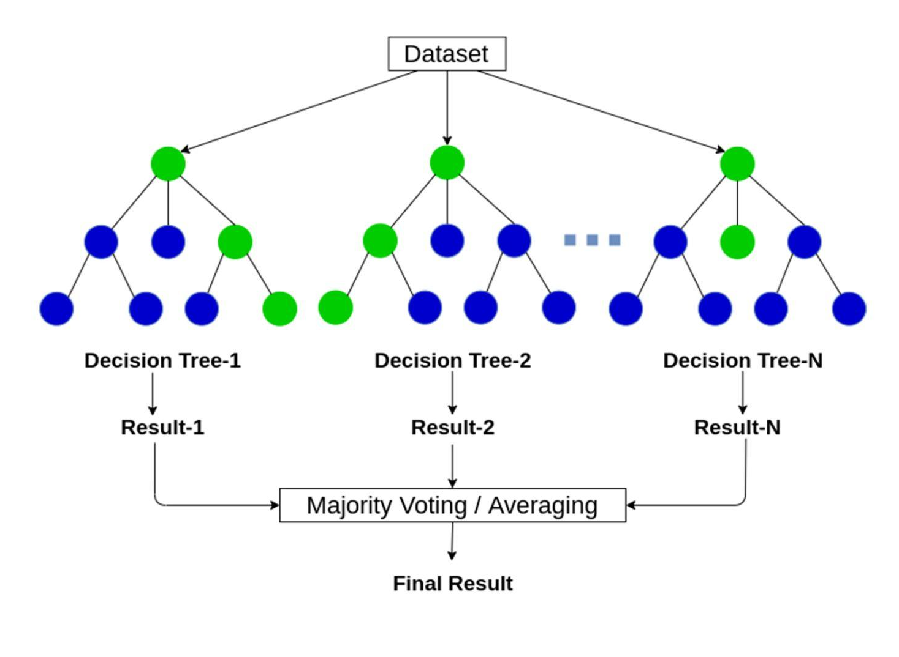
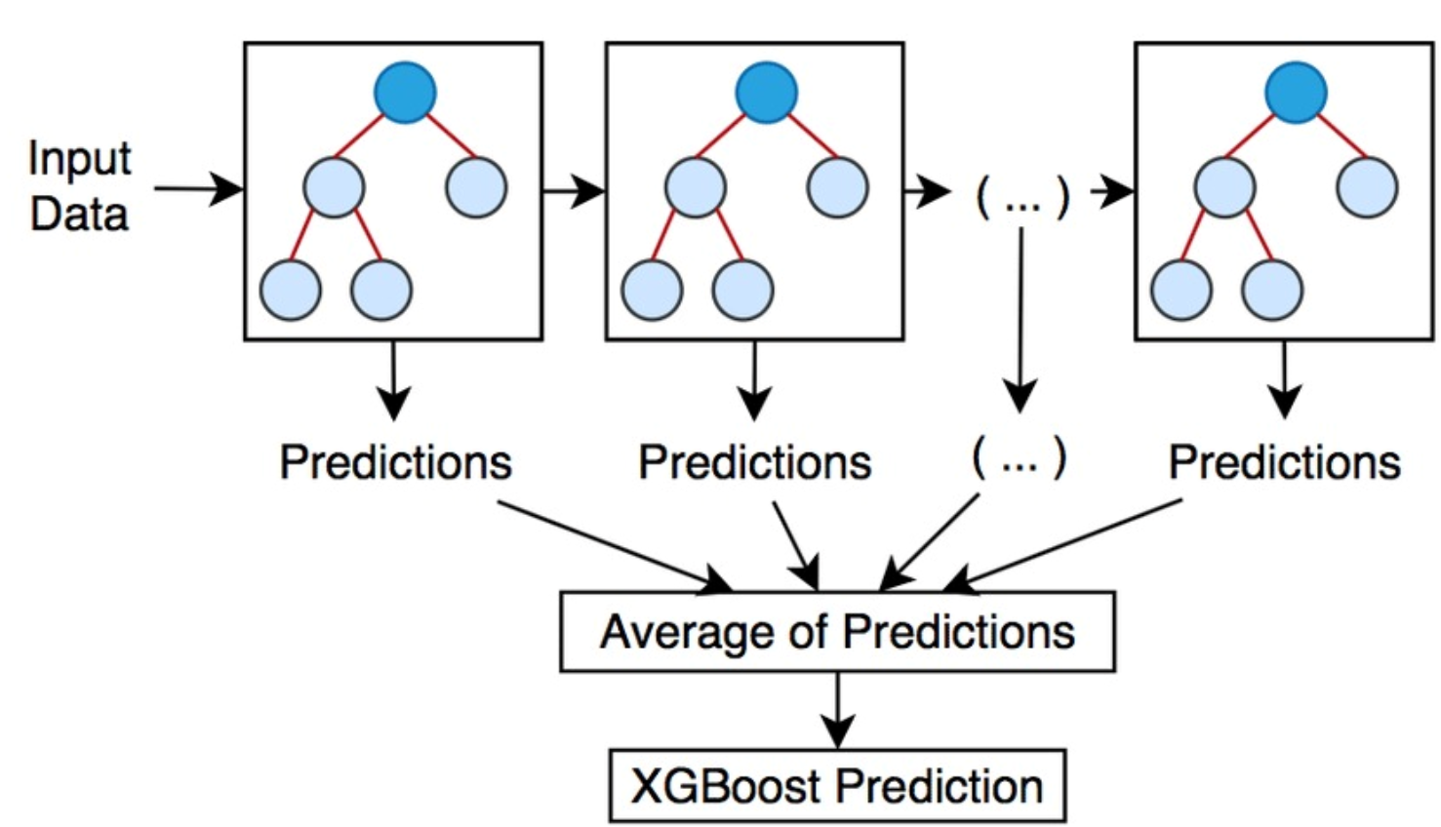
Modeling Approaches
Decision Tree analyzes features, asking questions to classify data points into categories. In contrast, in a random forest, multiple decision trees work to give the final prediction based on the most common decision among them.
Random Forest
XGBoost
Trains multiple decision trees, each learning from the mistakes of its predecessors to improve accuracy, ultimately combining their predictions for optimal results
Notes:
Knn- For instance, if the majority of nearby instances have a label of 1, we predict that the new instance will likely have the same label.
KNN: Imagine you have a group of friends who have different personalities, and you want to make a new friend who matches your interests. Now, you don't know much about this potential friend, but you do know a lot about your current friends.
KNN works kind of like this: It looks at your new friend's traits (like interests or hobbies) and compares them to your existing friends. The "K" stands for how many of your closest friends you want to consider. So, KNN finds the "K" friends who are most like your new friend in terms of their traits.
Once it finds those similar friends, it looks at how they feel about something (maybe a movie or a book). Then, it predicts how your new friend might feel about the same thing based on how their traits match up with your existing friends.
Decision Trees:
Imagine you're trying to make a decision, and you have a bunch of questions you could ask to help you decide. For example, if you're deciding what to wear, you might ask questions like "Is it raining?" or "Is it hot outside?" Each question helps you narrow down your choices until you make a decision.
A decision tree works similarly. It asks a series of questions about the data and uses the answers to classify or predict something. Each question splits the data into smaller groups, and the process continues until it reaches a conclusion, like whether a customer will buy a product or not.
Random Forests:
Now, think of a forest with many trees. Each tree (decision tree) in the forest is like a different person making a decision based on their own set of questions. Some people might focus more on the weather, while others might care more about the occasion.
Similarly, a random forest is a collection of decision trees. But here's the key: each tree in the forest is trained on a different subset of the data and asks different questions. When you want to make a prediction, you ask each tree in the forest and take a vote. The most popular prediction among the trees becomes the final prediction.
In simple terms, Decision Trees are like individual decision-makers, while Random Forests are like a diverse group of decision-makers working together to decide.
RF- but each focuses on different aspects of the data. When making a prediction, each tree contributes its decision, and the

Slide 13
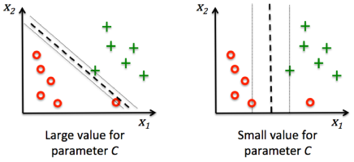
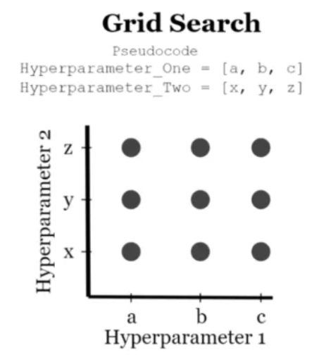
Model Improvements
Regularization
Grid Search + Cross-Validation
Regularization is used to prevent overfitting by penalizing the weights assigned to features. It has been applied in Logistic Regression and SVM to ensure they generalize well to unseen data.
Grid Search finds the optimal hyperparameter values for a model by evaluating the model's performance across different combinations of hyperparameter values within a predefined grid of values.
13
Notes:
is like adding guardrails to a road to prevent cars from veering off-track, ensuring they stay on the right path without going too far in any direction.
Grid Search CV is like trying out different routes on a map to find the quickest way to your destination, testing various combinations until you discover the most efficient route.

Slide 14

Results
Model | Accuracy% | Precision% | Recall% | F1 Score%
Logistic Regression | 62% | 62% | 62% | 62%
KNN | 59% | 59% | 59% | 58%
Random Forest | 62% | 62% | 62% | 62%
XGBoost | 63% | 63% | 63% | 63%

Slide 15
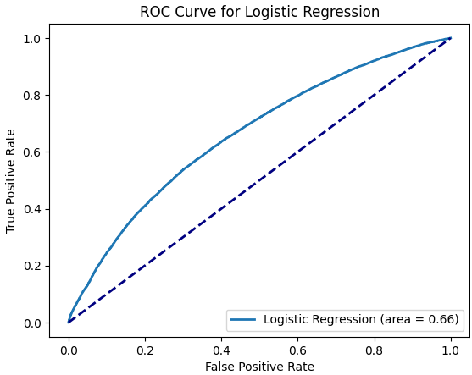
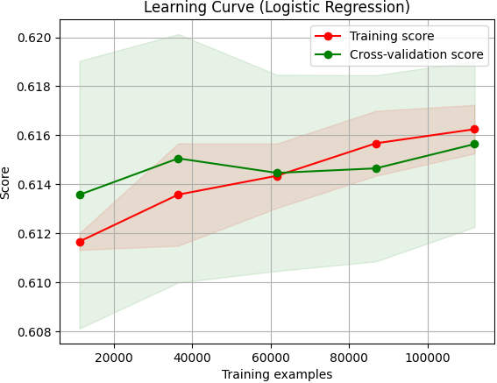
Result Analysis – Logistic Regression
Area Under ROC Curve : 66%
Accuracy: 62%
The model is a good fit.

Slide 16
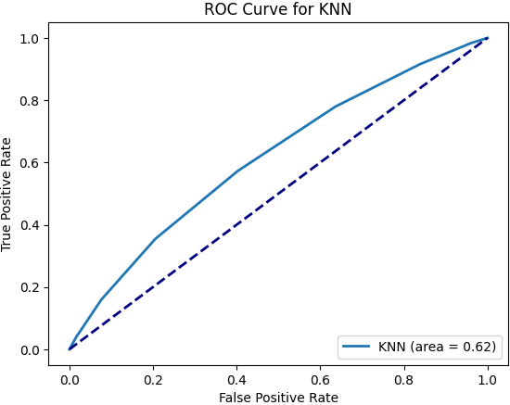
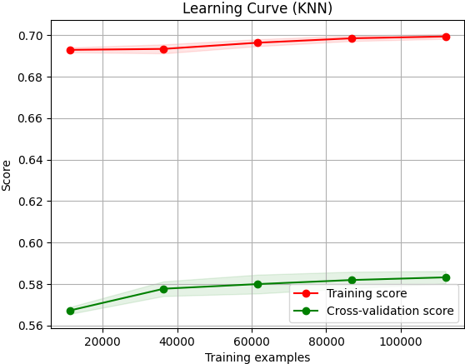
Result Analysis – K-Nearest Neighbour
Area Under ROC Curve: 62%
Accuracy: 59%
The model is overfitted.

Slide 17
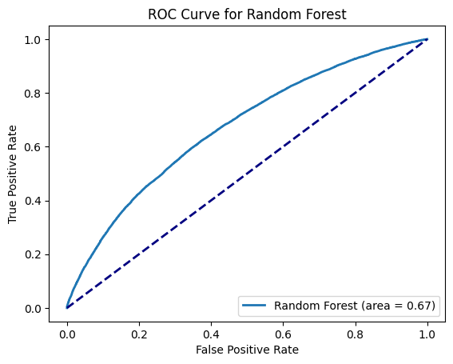
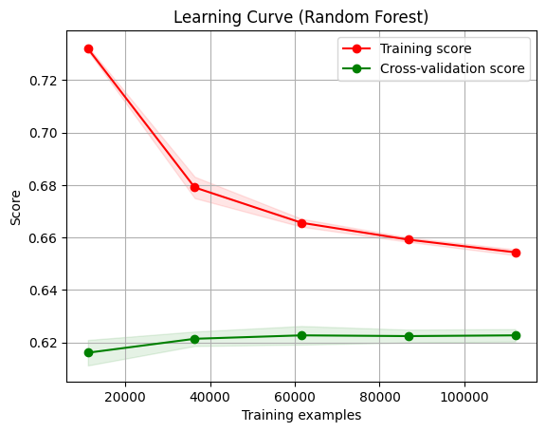
Result Analysis – Random Forest
Area Under ROC Curve : 67%
Accuracy: 62%
The model is a good fit.

Slide 18
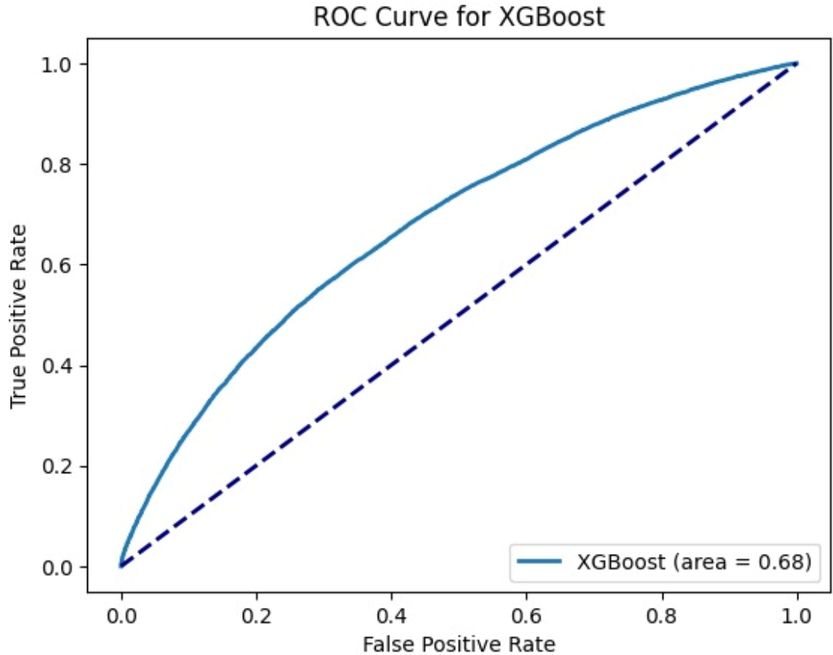
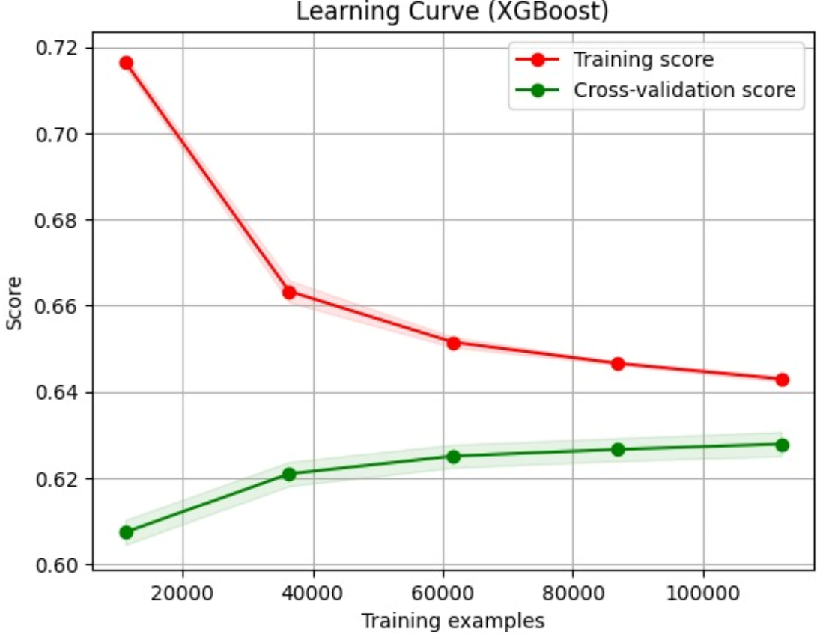
Result Analysis – XGBoost
Area Under ROC Curve : 68%
Accuracy: 63%
The model is a good fit.

Slide 19
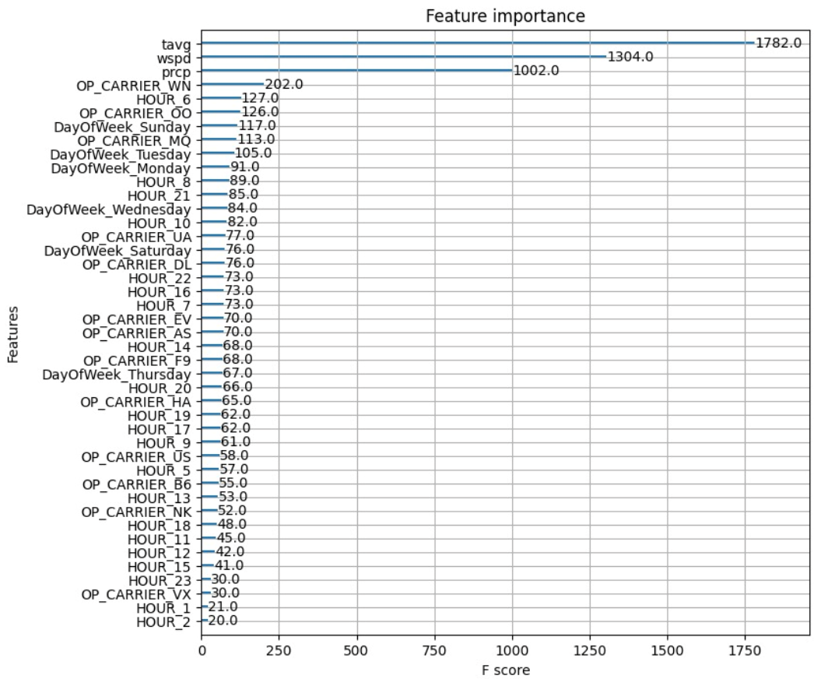
Analysis and Interpretation
XGBoost model achieves 68% accuracy, ensuring effective flight delay management for improved operational efficiency and passenger satisfaction
Strategic Planning: Optimizing Operations, Routes, and Resources for Enhanced Efficiency and Customer Satisfaction.
Resource Allocation: Empowering Cost Reduction and Profitability through Accurate Predictions.
Recommendations: Implement targeted strategies for routes prone to delays and invest in preventive maintenance programs to enhance operational efficiency and passenger satisfaction
Average temp., windspeed and precipitation holds maximum importance.
Sudden drop from 1002 to 202, because of pre-processing applied on features.
Notes:
2nd point Reference: Strategic Planning: The model offers insights for strategic planning in the airline industry, enabling optimization of operations, route planning, and resource allocation to improve efficiency and customer satisfaction. Resource Allocation: Accurate predictions empower airlines to optimize resource allocation, including staffing, maintenance schedules, and fuel management, reducing costs and enhancing profitability.
3rd Point reference:We recommend implementing targeted strategies to mitigate delays, such as adjusting flight schedules for routes prone to delays and allocating additional resources to expedite turnaround times.
Additionally, proactive measures, like investing in preventive maintenance programs, can address underlying issues and improve operational efficiency to minimize delays and enhance passenger satisfaction.

Slide 20
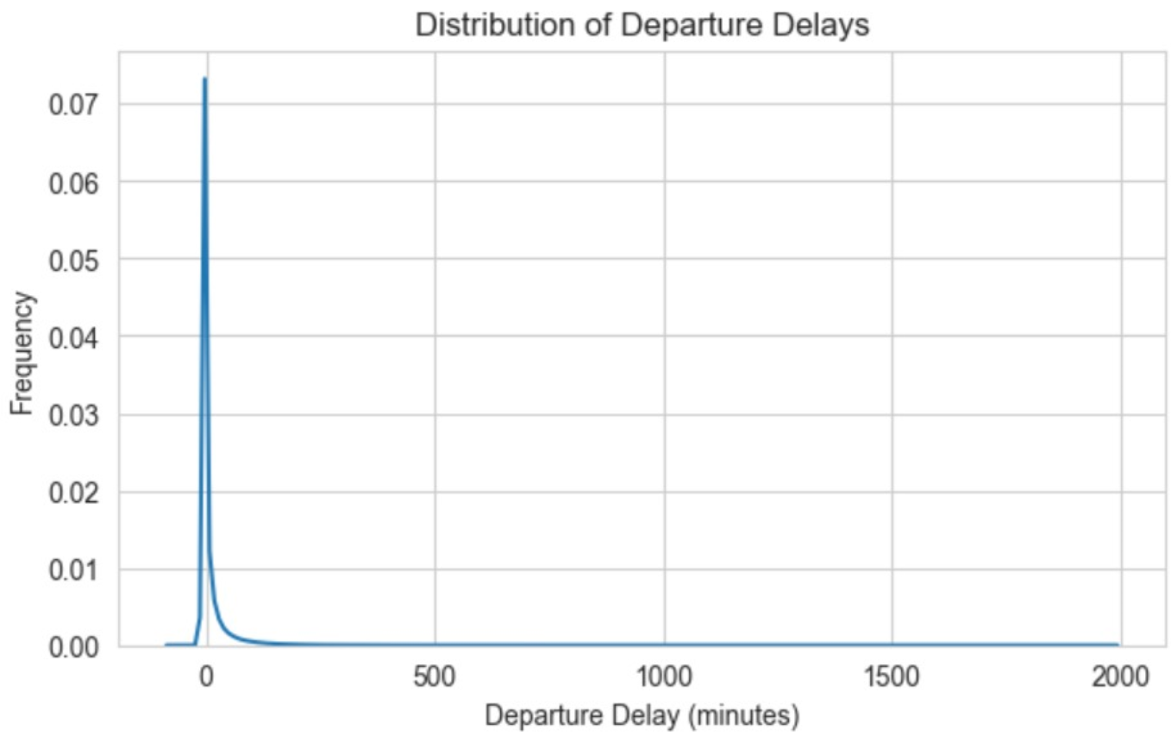
Model Critique
Initiated the project with a regression model but faced limitations due to missing critical features prompting a switch to classification.
2 Key Factors:
The Right-skewed distribution of departure delays data
Unavailability of delay related features like Weather delay, NAS Delay
Model Evaluation – Addressing Key Question
Training the model on such a large dataset required significant time, aggravated by the inclusion of hyperparameter tuning to enhance performance
Potential improvement strategy involves training the model on data specific to individual airports or airlines, which could streamline the training process and improve efficiency
Challenges and Future Improvement

Slide 21
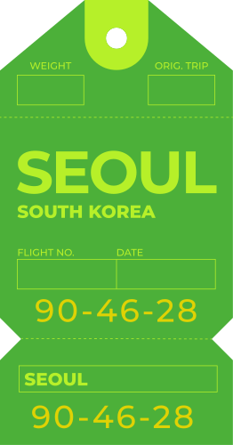


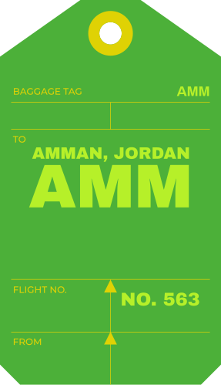
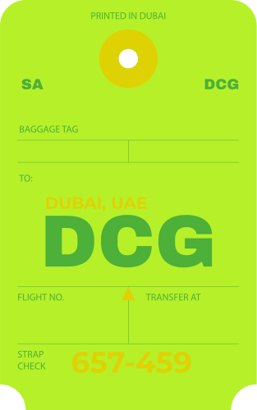



Conclusion
Airline delays significantly impact both airlines and customers, resulting in substantial financial losses.
Using machine learning for predicting airline delays improves operational efficiency, punctuality, and customer satisfaction in the dynamic airline industry, highlighting the importance of continuous monitoring.
Access to accurate and comprehensive data, including internal operations and weather conditions, is crucial for optimizing model performance and predictions.

Slide 22
References
Kaggle Dataset: https://www.kaggle.com/datasets/yuanyuwendymu/airline-delay-and-cancellation-data-2009-2018
Flight Delay Study: https://www.researchgate.net/publication/272202358_Total_Delay_Impact_Study_A_Comprehensive_Assessment_of_the_Costs_and_Impacts_of_Flight_Delay_in_the_United_States
Model Graphics from:
Random forest- https://anasbrital98.github.io/blog/2021/Random-Forest/
KNN- https://towardsdatascience.com/knn-k-nearest-neighbors-1-a4707b24bd1d
Regularization- https://www.bogotobogo.com/python/scikit-learn/scikit_machine_learning_Support_Vector_Machines_SVM.php
Grid Search- https://medium.com/@ravikumar10593/grid-search-cv-vs-randomize-search-cv-54708be0d599
XGBoost - https://www.researchgate.net/figure/XGBoost-model-Source-Self_fig2_350874464

Slide 23
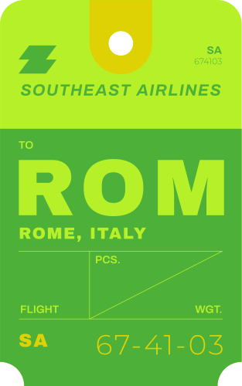


Thank you!

